Slide 1
An Overview of
Taiwan’s Status and the
Functioning of the Universe
Taiwan Status
Action Coalition
Version 1.05

Slide 2
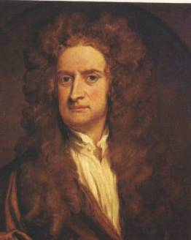
Issac Newton (1642 – 1727) was an English physicist, natural philosopher, mathematician, and astronomer. During the lifetime of Newton, astronomers knew of eight planets, which included Mercury, Venus, Mars, Jupiter, Saturn, Uranus, Neptune, and our Earth.

Slide 3
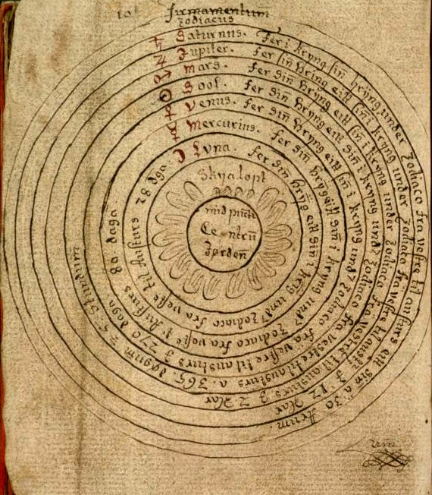
During the 1600s and into the 1700s, the religious teachings of the Church were very authoritarian. The official teachings held that the Earth was the center of the Universe.

Slide 4
According to Newton’s reasoning and observations, an apple falling to the ground, a planet revolving in the heavens, or a comet traveling around its orbit all depend on the same principle. He called this “gravity” or “gravitational interactions,” which he defined as the mutual attraction between any two bodies in the universe. Today we know that gravitation is one of the four fundamental interactions of nature.

Slide 5
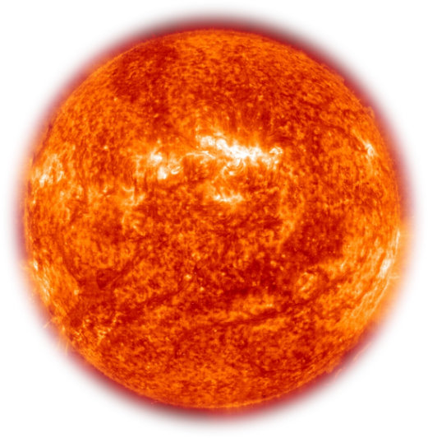
However, in the Catholic Church, the Pope’s strict teachings held that the Earth was the center of the Universe. It was stated that the Sun orbited the Earth, and this was easily verifiable. Simply watching the sun rise in the east at dawn, and descend in the west at sunset, was proof that the Earth occupied a central position.

Slide 6
Newton said that it was possible to calculate the movements of the other seven planets by following the premise that the Earth was at the center of the planetary system.
However, the calculations were extremely complicated, and lacked any sense of symmetry or organization. Under such a formulation, it was also necessary to assume that the planets traveled at different speeds during different periods of their movements throughout the heavens.

Slide 7
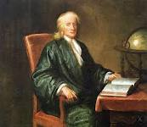
However, based on the fundamental principle of gravity, Newton felt it more likely that the movement of the planets could be explained in a simple and systematic manner.
He therefore decided to discard the premise that “The Earth is the center of the universe.”

Slide 8
In Taiwan, for over sixty years we have been taught by an authoritarian government to believe that –
The Republic of China is an independent sovereign nation, and is now located in Taiwan.
So, it follows, Taiwan is the ROC, and the ROC is Taiwan.
In the 1980s, the Democratic Progressive Party was founded. Today the DPP continually proclaims that –
Taiwan is an independent sovereign nation, and its name is the Republic of China.

Slide 9
The Pope asked you to use your eyes, and to notice the movement of the Sun.
It comes up in the morning, and goes down in the evening, isn’t that right?

Slide 10
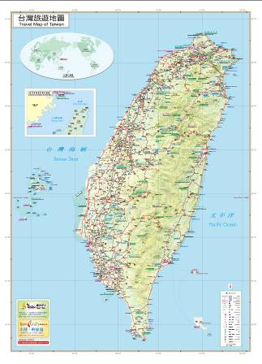
In a similar fashion, we can use our eyes, and we can see that the Republic of China in Taiwan appears to meet all of the criteria under international law to be regarded as a sovereign nation.
These criteria include:
Defined territory
Permanent population
A government
The ability to conduct foreign relations.

Slide 11
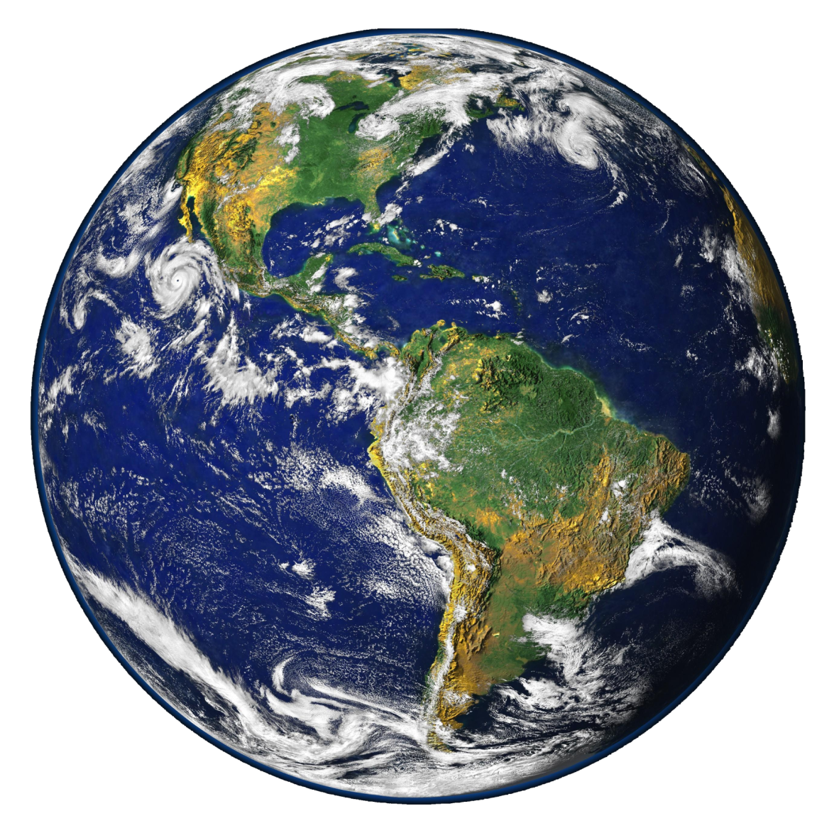
However, in reality, when we attempt to examine the correctness of these four criteria in more specific detail, we quickly run into problems.

Slide 12
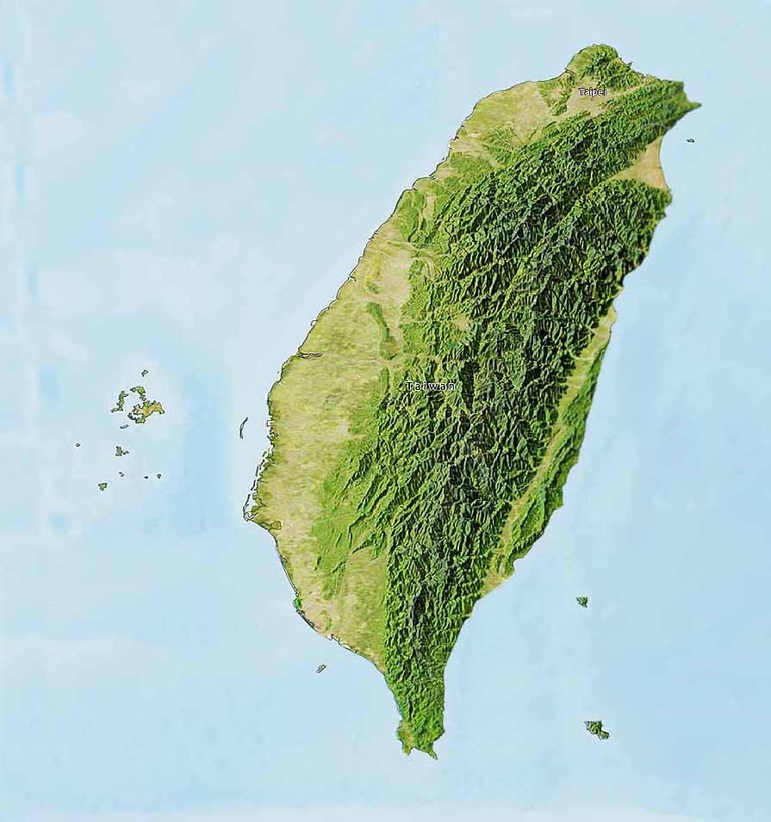
For example, in regard to “defined territory,” the ROC government is very authoritarian, and in the local history books all students are taught that Oct. 25, 1945, was “Taiwan Retrocession Day.”

Slide 13
However, from a more international point of view, some basic research quickly reveals that none of the Allies (and in particular the USA, UK, and France) agreed to such an interpretation of the legal significance of Oct. 25, 1945.

Slide 14
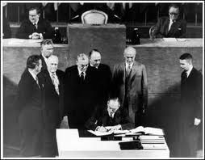
In addition, from the point of view of the “ownership” of Taiwan territory, it is very clear that Taiwan does not belong to China.
In particular, the San Francisco Peace Treaty (SFPT) did not award Taiwan territory to China; moreover, the Treaty of Taipei merely confirmed the arrangements made in the SFPT.

Slide 15
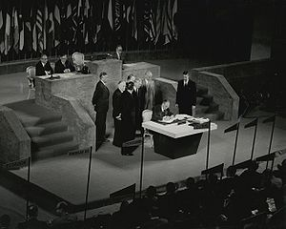
The signing of the SFPT on Sept. 8, 1951 in San Francisco, California.

Slide 16
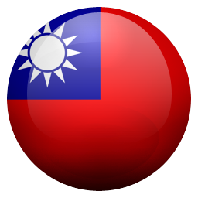
Article 4 of the ROC Constitution specifies that
"The territory of the Republic of China within its existing national boundaries shall not be altered except by a resolution of the National Assembly."

Slide 17
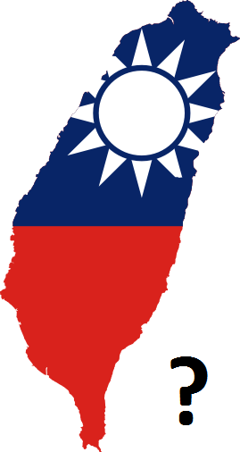
So, we may ask, when was Taiwan incorporated into the national territory of the ROC via the provisions of this Article?
After careful research, we are forced to conclude that in regard to the alleged incorporation of Taiwan into Chinese territory, there is no resolution of the National Assembly on record!! Clearly then, the criteria of “defined territory” is very questionable.

Slide 18
What about “permanent population”?
Although there were some proclamations made in the Fall of 1945, the most commonly quoted reference for the "legal basis" of native Taiwanese persons as having ROC nationality is a Jan. 12, 1946, order issued by the ROC military authorities.

Slide 19
However, regarding this mass naturalization, officials of the British and American governments made protests on three separate occasions, pointing out that there was no legal basis for such an order.
After all, the post-war peace treaty had not yet been drafted or signed.
Importantly, as the military occupation of Taiwan began on October 25, 1945, with the surrender of Japanese troops, such an order is prohibited under the laws of war.
From the perspective of ROC law, it is also impossible to understand the legal basis for such a military order.

Slide 20
ROC Constitution

Slide 21
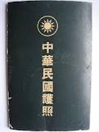
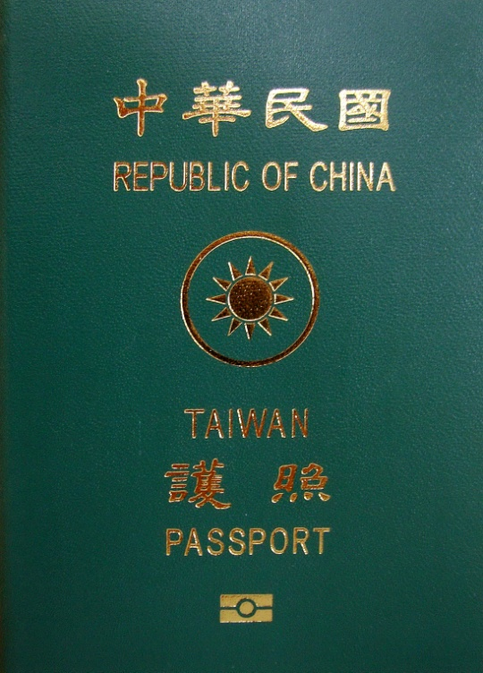
The ROC Passport

Slide 22
As regards this 1946 mass naturalization, neither the ROC Nationality Law nor the Constitution has any relevant provisions.
Additionally, the contents of this military order were never ratified by the Legislative Yuan, nor made into a law.
Clearly then, the criteria of “permanent population” is very questionable.

Slide 23
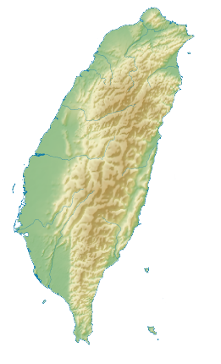
What about “government”? The ROC central government relocated to Taipei, Taiwan, effective Dec. 10, 1949. However, at that time Taiwan was still sovereign Japanese territory, it was not Chinese territory.

Slide 24
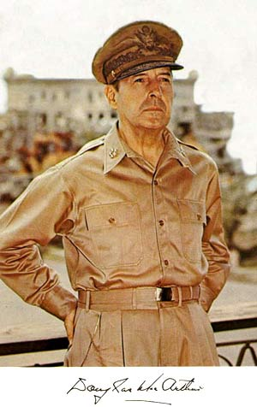
General Douglas MacArthur stated at a congressional hearing in May 1951, “Legalistically Formosa is still a part of the Empire of Japan.”

Slide 25
From an examination of these simple facts, it is obvious that the status of the ROC government in Taiwan is abnormal.
?

Slide 26
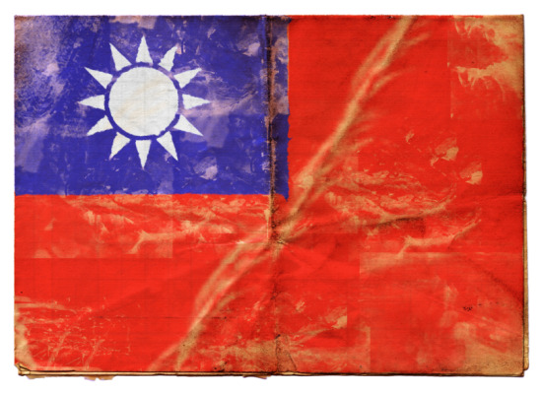
The fourth criteria is the ability to conduct foreign relations.
As explained above, when the ROC moved its central government to Taiwan in December 1949, it was moving outside of its own national territory.
Under international law, this means the ROC became a government in exile.

Slide 27
Today, many people are still confused about the historical and legal record, and say that “Taiwan equals the ROC.” However, such a statement is erroneous.
Consequently, we should recognize that the ROC government’s efforts to build “foreign relations” with other countries in fact have little or no relevance to Taiwan.

Slide 28
After examining these four criteria in detail, we need to follow in the path of Issac Newton, who bravely cast aside the Pope’s teachings. We need to courageously discard the premise that the ROC educational and political authorities have used to brainwash us for so many years, namely –
“The ROC on Taiwan is a sovereign independent nation.”
In international political and legal circles, such a premise is untenable.
Moreover, such a premise is actually very dangerous!!

Slide 29
Ministry of Foreign Affairs, Republic of China on Taiwan

Slide 30
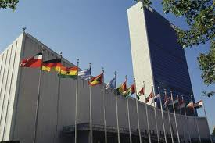
We must not forget that in the international community, “the People’s Republic of China is the successor to the Republic of China.”
Certainly, the United Nations and all its subsidiary agencies all hold to such an interpretation.

Slide 31
So, if we stress that the Republic of China in Taiwan is a sovereign independent nation, we are forced to conclude that Taiwan belongs to the People’s Republic of China (PRC)!!

Slide 32
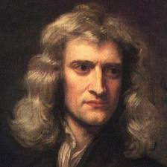
Issac Newton

Slide 33
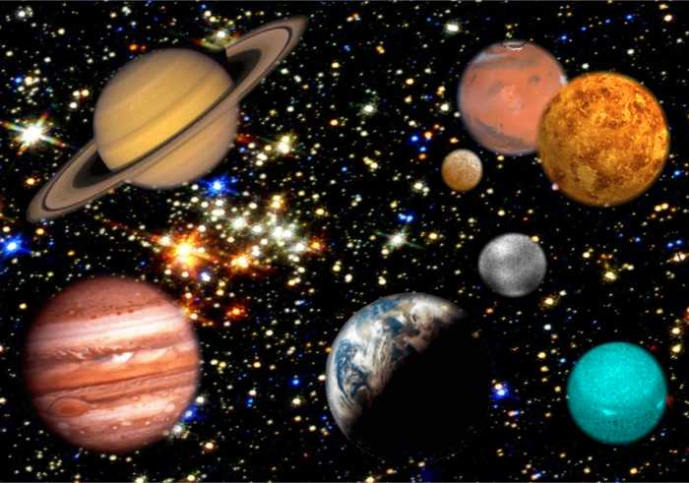
Newton wanted to calculate the motion of the planets, so he needed to find a new premise on which to base his calculations.
We want to discuss Taiwan’s international legal position, and we also need to find a new premise on which to base our discussions.
What are the important aspects which we should take into consideration?

Slide 34
After careful observation of the historical and legal record, we have found that the significance of “the surrender of troops” must be more carefully described and explained.
In reality, “surrender” marks the end of the hostilities, and the beginning of the military occupation.
“Surrender” cannot be interpreted as effecting a transfer of territorial sovereignty, or as authorizing the annexation of territory.
Here are eight historical examples.

Slide 35
End of Hostilities (Surrender, Armistice, etc.) Dates and Location
1847.01.13 California
1898.06.21 Guam
1898.07.17 Cuba
1898.08.12 Puerto Rico
1898.08.14 Philippines
1945.09.07 Ryukyu Islands
1945.10.25 Taiwan
2003.03.20 Iraq

Slide 36
From this summary, it should be easy to understand the principle that “the conqueror is the occupying power,” or more specifically “the conqueror is the principal occupying power . . . . . ”
Significantly, the military occupation of an area or territory can be delegated to the military troops of another country. This creates a principal – agent relationship.

Slide 37
The concept of “military government” is also important to understand.
Military government is the form of administration by which an occupying power exercises governmental authority over occupied territory.
From an examination of the historical record, we ascertain that it was the United States of America which conquered Japan, and which conquered (Japanese) Taiwan.
Hence, it follows that
(a) the USA is the principal occupying power, and
(b) a US federal agency, the United States Military Government, has administration rights over Taiwan.
This is the basic formulation.

Slide 38
In the past 100 years, the highest ranking international legal document dealing with the disposition of Taiwan is the SFPT.
The SFPT came into force on April 28, 1952.

Slide 39
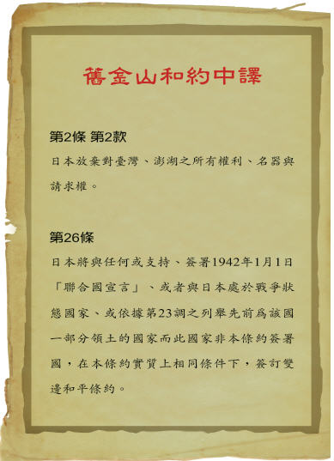
Chinese translation of the SFPT

Slide 40
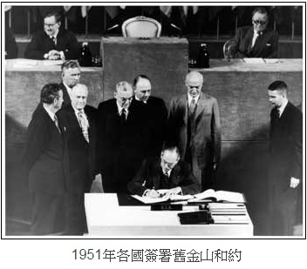
When reading this treaty, we should pay particular attention to Articles 2(b), 4(b), and 23(a).
2(b)
Japan renounces all right, title and claim to Formosa and the Pescadores.

Slide 41
4(b)
Japan recognizes the validity of dispositions of property of Japan and Japanese nationals made by or pursuant to directives of the United States Military Government in any of the areas referred to in Articles 2 and 3.
23(a)
. . . . . including the United States of America as the principal occupying Power, . . . . .

Slide 42
In the above three Articles, the legal situation which we see is as follows:
The United States of America is the principal occupying power. The United States Military Government (USMG) has disposition rights over Taiwan, in essentially the same manner as it had disposition rights over the Ryukyu island group.

Slide 43
So, according to the same formulation, we should immediately recognize that:
The ID Cards and Travel Documents (passports) which native Taiwanese persons carry should be issued by the United States Military Government, in a similar fashion to the arrangements for native persons in the Ryukyu island group from 1945 to 1972.
The Republic of China is merely serving as “agent” for the United States Military Government in the military occupation of Taiwan territory, and there is no legal basis to use the ROC label in issuing ID Cards and Passports to local Taiwanese persons. This is especially true since the ROC on Taiwan is a government in exile.

Slide 44
In light of the above analysis, we can quickly see what the correct path for Taiwan’s future development is.
Taiwan should first promote self-rule, and then move toward establishing nationhood.
The United States military authorities should terminate the “agency” relationship with the ROC.
ROC government officials and other ROC loyalists could then actively make plans to move back to their beloved homeland – Mainland China.

Slide 45
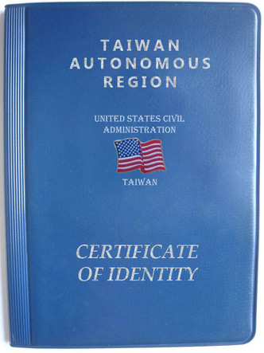
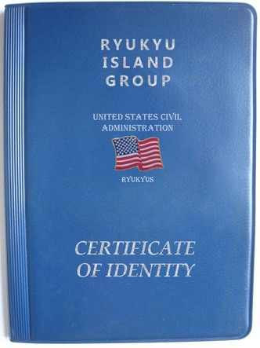
Passport Design Samples (1)

Slide 46
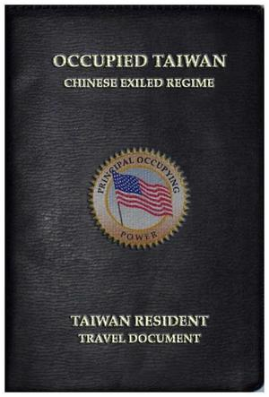
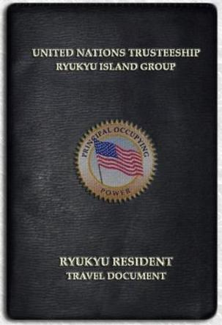
Passport Design Samples (2)

Slide 47
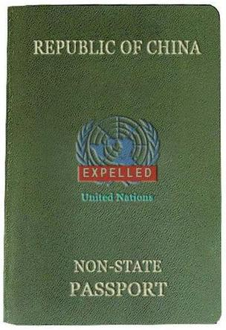
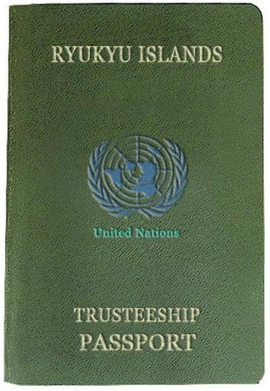
Passport Design Samples (3)

Slide 48
Additionally, those loyal to the ROC could then actively pursue the development of the notion of “One Country, Two Areas.”
(The Two Areas spoken of here are correctly understood to be “Mainland China” and the “Kinmen –Mazu island groups.”)

Slide 49
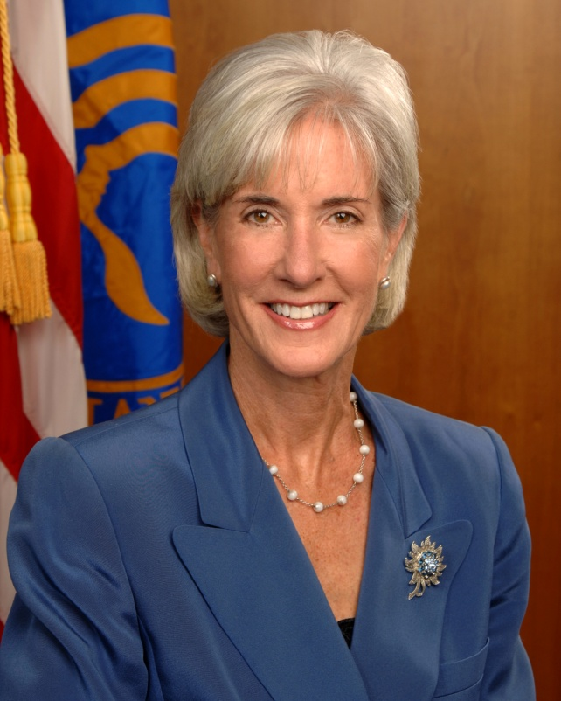
US Secretary of Health and Human Services Kathleen Sebelius

Slide 50
On May 17, 2011, Kathleen Sebelius, the US Secretary of Health and Human Services announced to the World Health Assembly:
“We have made it very clear to the WHO that the United States' position is that no organization of the U.N. has a right to unilaterally determine the position of Taiwan.”

Slide 51
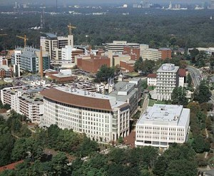
Secretary Sebelius further stated that the United States was very happy to support the application of Taiwan (Chinese Taipei) to be an observer in the WHA.
CDC Headquarters, Atlanta, Georgia USA

Slide 52
In truth, in the post WWII era, the USA is serving as the trustee/administrator of Taiwan, and has the authority to significantly influence the direction of Taiwan’s future development. There are qualified local groups in Taiwan which are willing to cooperate with the US government to handle all matters concerning hygiene and sanitation, disease control, medical prescriptions, medication management, and other public health issues. It is also hoped that the US Centers for Disease Control set up a offical USCDC-Taiwan Branch in the near future.

Slide 53
We are Taiwanese, not Chinese!!

Slide 54
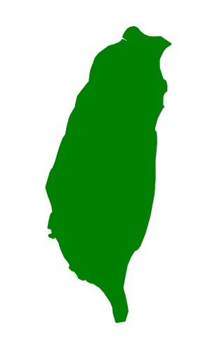
Taiwan and China did not “spit in 1949” – they weren’t together to begin with! Taiwan has been occupied territory since Oct. 25, 1945, and it’s territorial sovereignty has never been transferred to China!
TAIWAN
Native Taiwanese people are not “Chinese,” and should not be carrying Republic of China passports.
The PRC has never ruled Taiwan
IS NOT
“Chinese Taipei” is simply an abbreviation for “Chinese government in exile in Taipei.”
Taiwan is not a “renegade province” of China
CHINA
The post-WWII San Francisco Peace Treaty did not award Taiwan to China. In the treaty, Taiwan was left under the jurisdiction of a U.S. federal agency – the United States Military Government (USMG).
The Republic of China in Taiwan is (1) a goverment in exile, and (2) a proxy occupying force for the USA.

Slide 55
THE END

